Slide 1
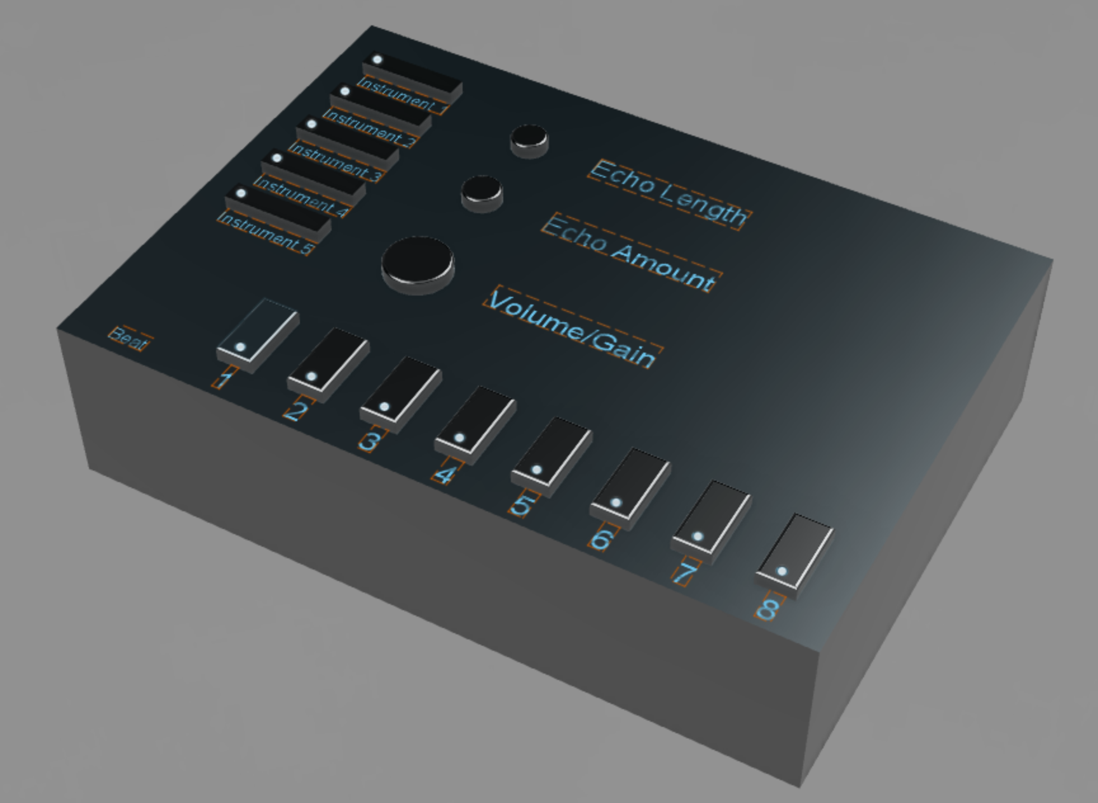
iDrop
Inspiring people to “drop” their own musical creations.

Slide 2

Product Vision
Our wish is to inspire individuals of any age or background to make music.

Slide 3
Who are we?
We are LC7 Group 1 from the ENEL-ILS 300 program at the
University of Calgary.
We are four electrical engineering students who are passionate about creativity, as well as inspiring others to embrace their creative capacity!
The iDrop is a product that we created to inspired individuals to start making music!

Slide 4
What do people need to start making music?
Headphones, microphones, speakers
These are really easy to find online, the average person can find these for reasonable prices
A creative workspace is required
Many digital workspaces can be found online… which one should you choose?
Experienced musicians can just use their instruments
What about the inexperienced musicians?

Slide 5
Problems that beginners are facing…
Difficulties trying to get into music
Product offering expensive
Software is hard to use
Beginners are trying to learn the fundamentals of music
Many products expect you to know some musical skills already
Chords, Melodies, Musical Notes
The iDrop is targeted towards beginner musicians, or young people who wish to learn more about music. We start by helping beginners develop a sense of rhythm, which can easily be done using drums.

Slide 6
What does the iDrop offer?
Starting with a simple drum machine, the iDrop offers real drum samples that the user can use to create their own beat patterns.
The iDrop product will be sold at $85. Production of the iDrop only costs $45, allowing for a $40 profit per sale. This is a fair price granted that young people are our target audience.
The physical machine has dimensions of 8x11x2 (inches), which helps keeps our costs low for production.
We offer up to 4 built in drum kits.
With such a variety of instruments to choose from, we offer the opportunity to create many beat patterns for cheap!

Slide 7
Some Products that are in the Market
Many physical alternatives usually end up costing a lot
Arturia Drum Machine (~$480)
Akai Force (~$1299)
Software alternatives are usually complex and only offer full functionality based on pricing
FL Studio
Requires only $99 for beat making, but $199 for song creation / microphone recording
Logic Pro X
Costs $200 dollars for the software, however many features and configurations are provided, which may be confusing to a beginner
Only available for Mac users
Adobe Audition
Can only commit to monthly/yearly licenses
It takes a while for bugs to be fixed by the Adobe company

Slide 8
Main Competitors
PO 32
Costs about $120
Uses drum synths, which sound like real drums, but are not actually real samples
Additional plug-ins cost about $140 more, and require you to already have a digital workspace (we do not expect the user to have any knowledge regarding digital-audio workspaces)
Korg Volca beats
Costs about $210
This product uses analog synthesis, which is not as flexible for creating beat patterns because, again, the synths are not actual drum samples
Machine is relatively small, which does not offer as much of a tactile experience as we would like for a beginner musician

Slide 9
Why choose the iDrop?
Simple to use for all ages
Only the most necessary functions for music creation are included
It doesn’t take long to gain experience
The iDrop does not require knowledge of complex configurations that many mainstream alternative products use
The beat sequences are easy to create
Stimulates Creativity
This is important to us because we believe that a user who tries our product will be able to express themselves through music

Slide 10
Manufacturing of the iDrop
For the physical prototype:
We planned to 3D print the casing using PLA filament, which is recyclable and 100% biodegradable
The electronics behind the product include a PCB that was provided to us by the University of Calgary
The PCB can be reused for smaller electronics projects
For the software:
The code is developed in C and is ready to be ported onto a PIC32 microcontroller
An estimated 35 hours was taken to create this software from scratch and experiment

Slide 11
Patents and Trademarks
According to the WIPO brand database, only a total of 39 trademarks have been found for the terms, ’iDrop’ or ‘iDrops’, but none of them exist in Canada (as of April 2020)
None of the existing trademarks were related to music
Using Google’s patent search, “drum machine” only shows results for patents related to washing machines, which are unrelated to music

Slide 12
Additional Features of the iDrop
Saving and Exporting beat patterns
Can currently can export .wav files from the software program
Changing the Gain, Echo, and BPM
Gain and Echo are simple audio effects that we provide to the user
BPM (beats per minute) controls the tempo at which the rhythm plays
Other drum sets are provided
Instead of working with only one drum kit, we offer up to 4 different drum kits with 6 samples each.

Slide 13
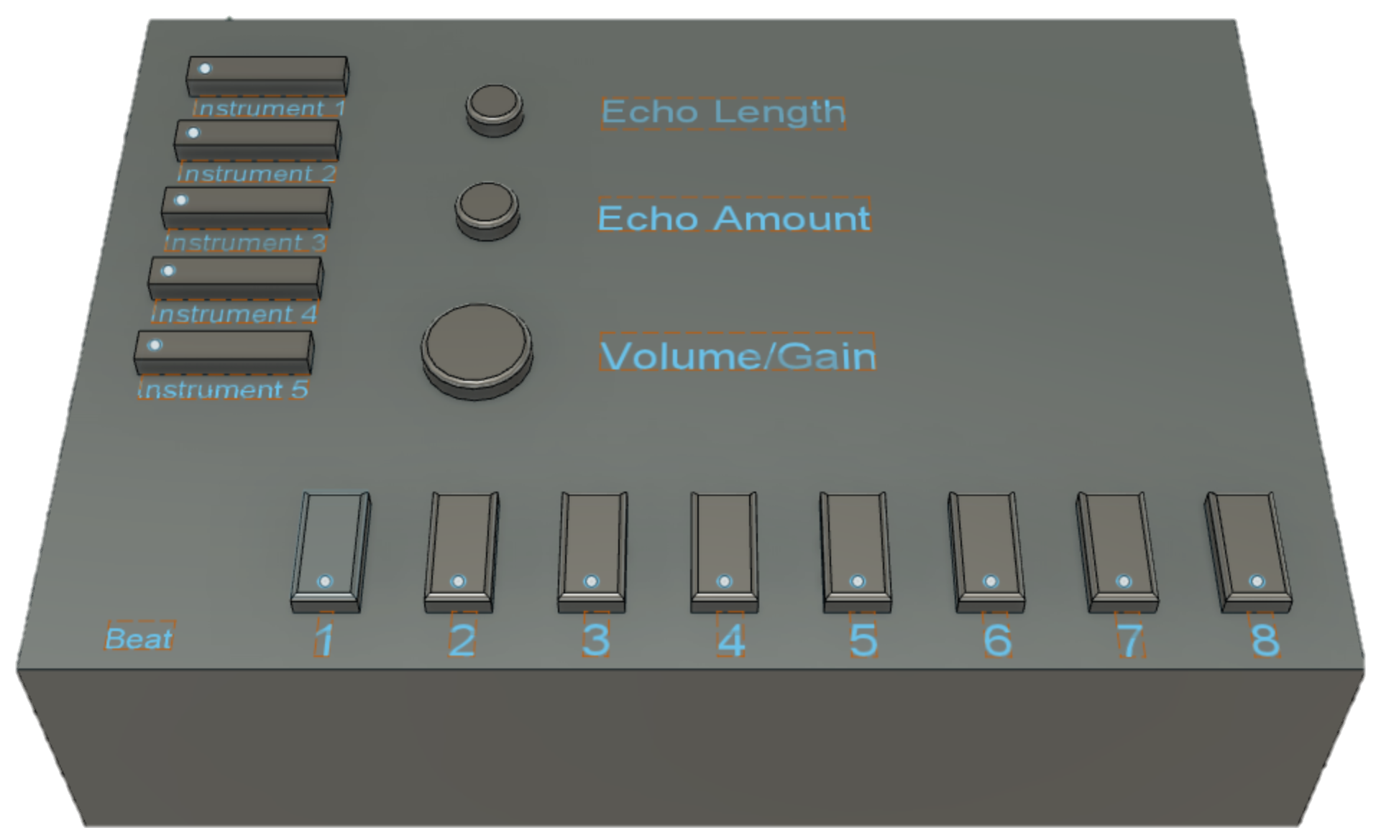
iDrop Physical Layout
Notes:
Physical Copy of the Drum Machine (Pre-COVID 19)

Slide 14
Because of the COVID-19 lockdown measures, the physical prototype could not be built for presentation.
Therefore, we have decided to simulate the iDrop using software. This software was created to provide a similar experience to using the physical prototype.

Slide 15
Software Demonstration

Slide 16
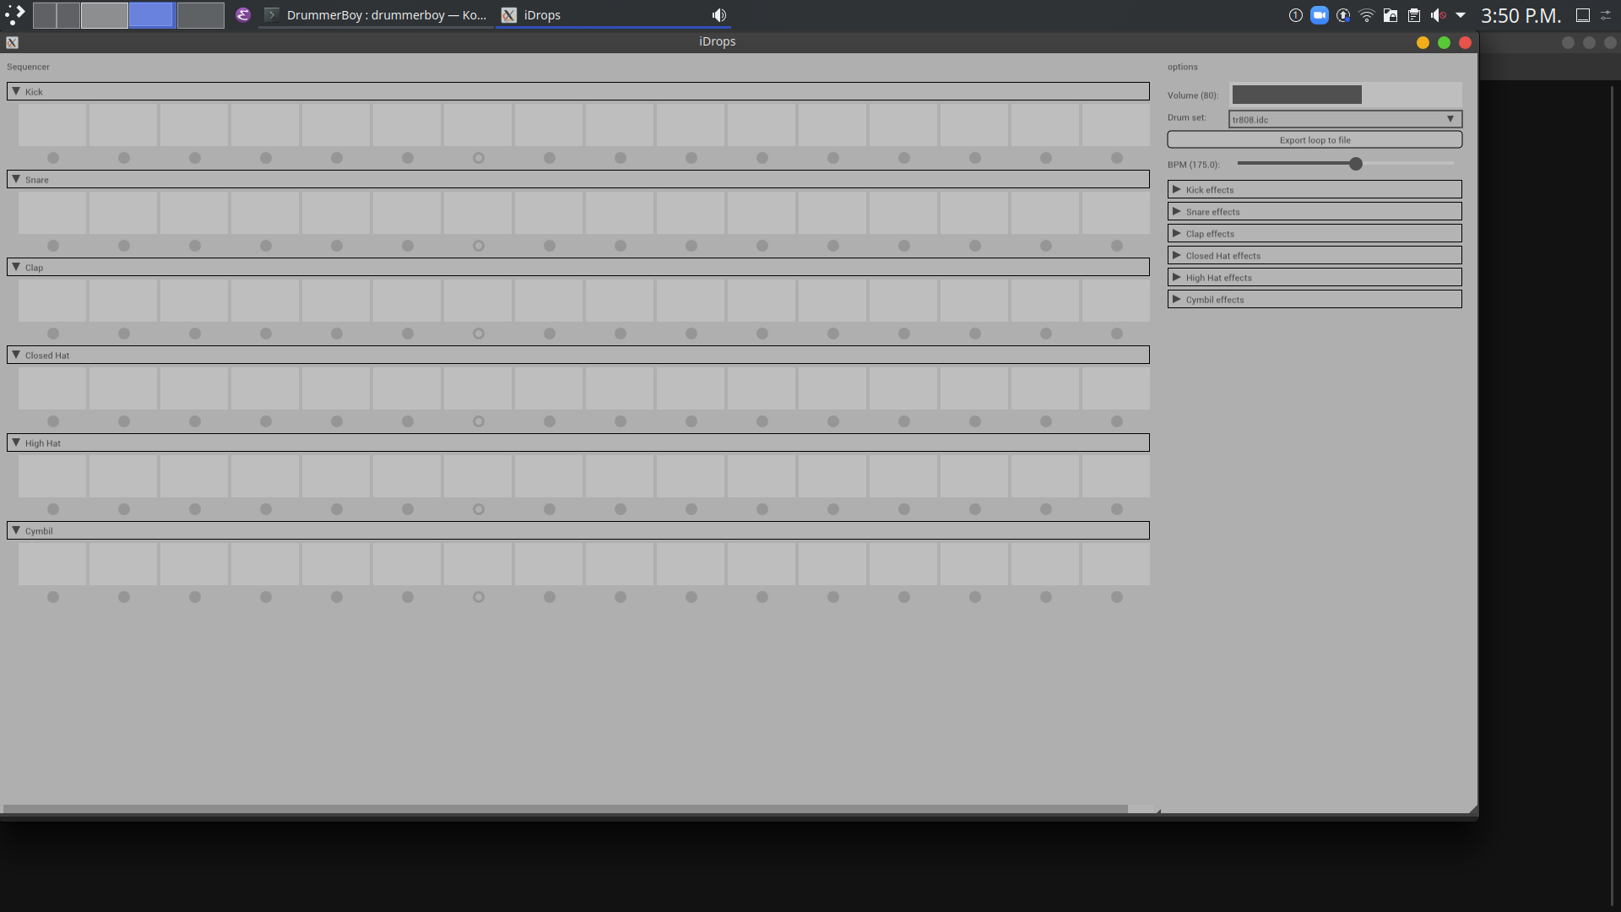
On this side, there are drop-down menus for each instrument, as well as sliders for the Volume and BPM.
This side displays the sequence selection for the instrument. By clicking on a square, the instrument will play when that beat is selected by the sequence. The sequence is played from left to right, as indicated by the bright circles underneath the squares.
This is the default layout for the software.
No instruments are turned on.
Notes:
Software Adaptation of the Drum Machine (Post COVID-19)

Slide 17
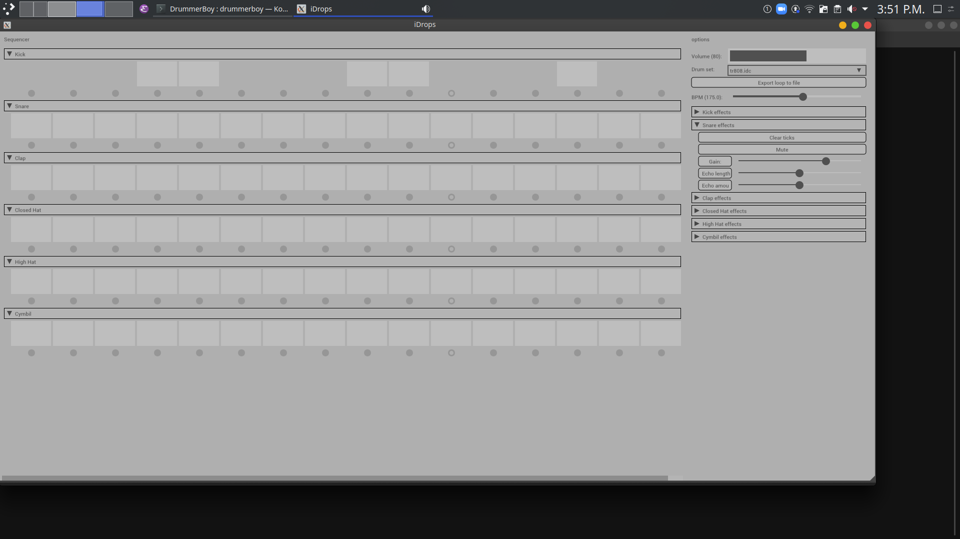
The drop-down menu for the is selected, and options such as Clear Ticks and Mute appear.
Sliders for the Gain and Echo are included as well.
By clicking on the squares, they disappear, meaning that the Kick instrument is now being played on the sequence.
Notes:
Instrument 1 on

Slide 18
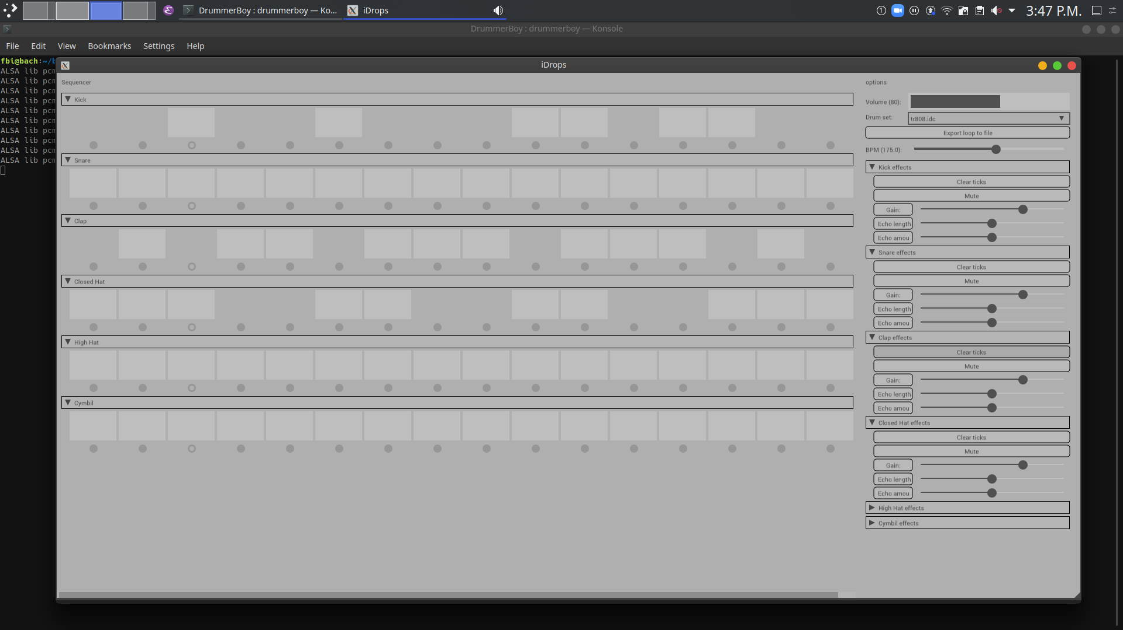
The drop-down menus show how the settings for each instrument can be changed simultaneously.
A rhythm sequence using 3 instruments is shown. (Kick, Clap and Closed Hat)
By clicking on the Clear Ticks button for the Clap Effect…

Slide 19
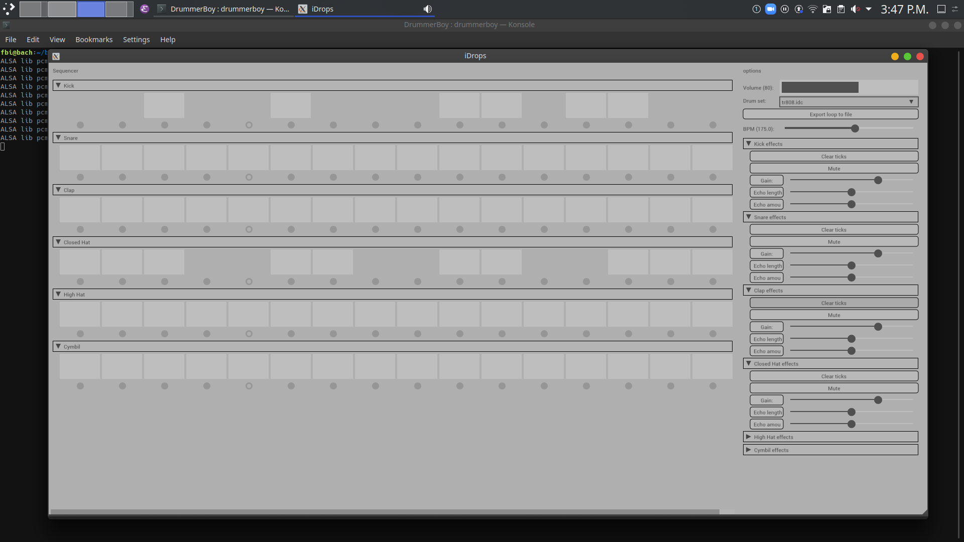
The Clap instrument is now cleared from the sequence.
Notes:
Instrument turned off (using CLEAR TICKS button)

Slide 20
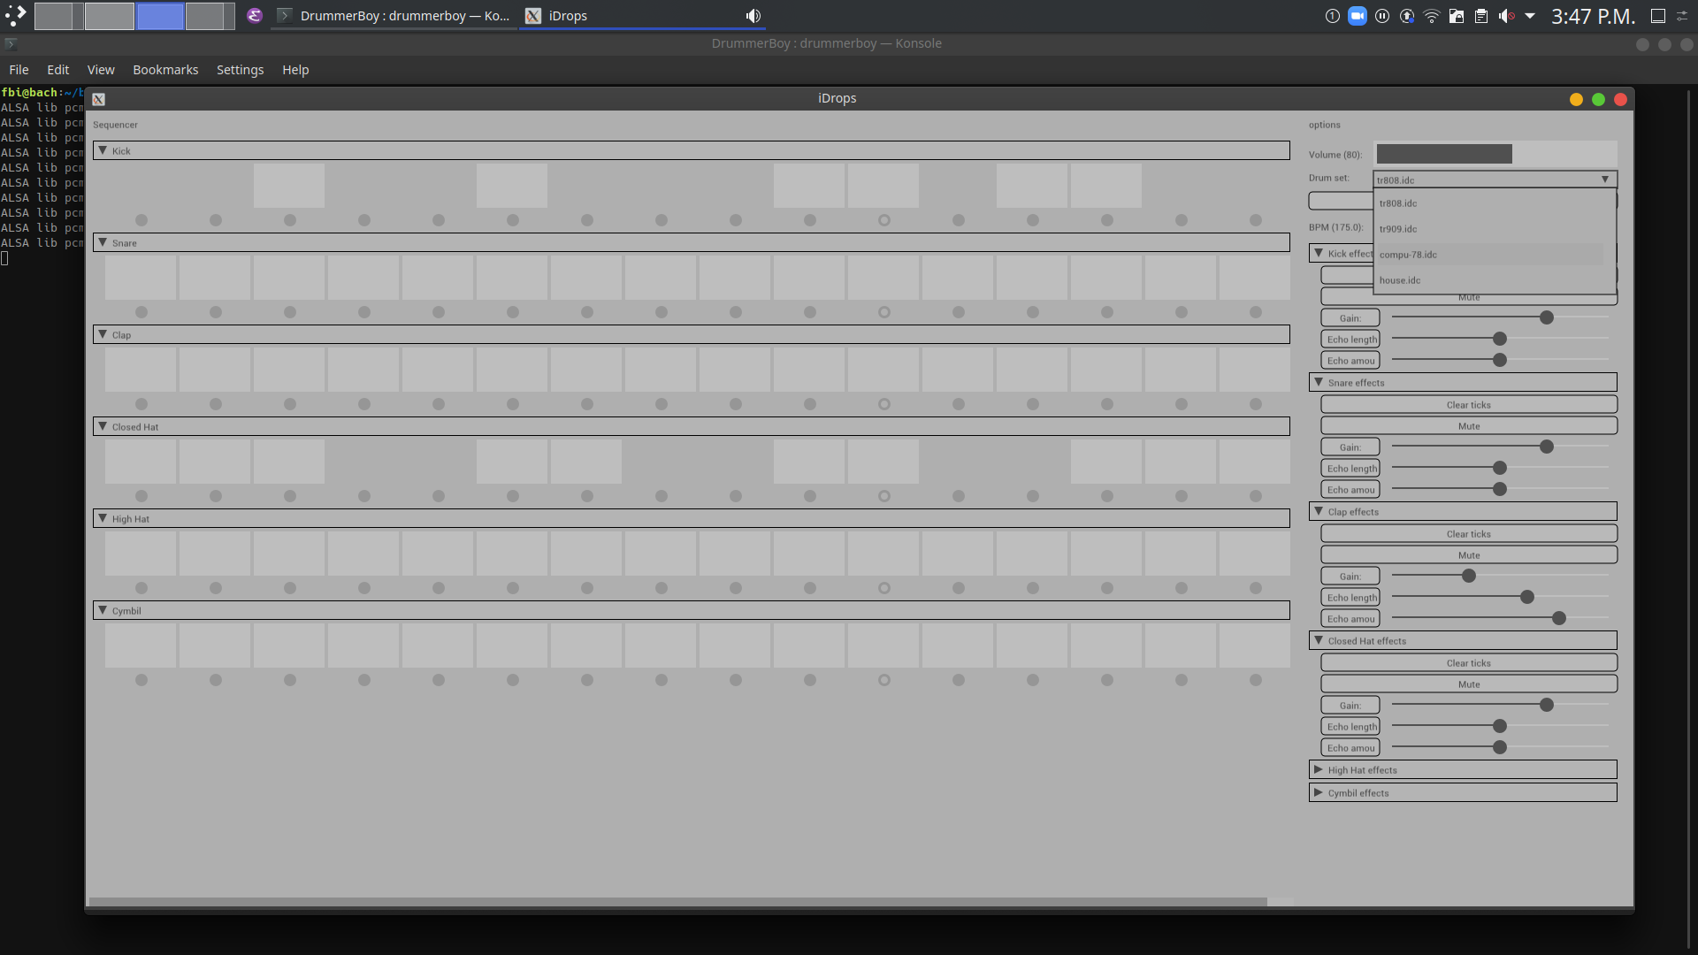
We can also change the drum set by using the drop-down menu located in the upper right corner.
Different drum sets may use different sounds.

Slide 21
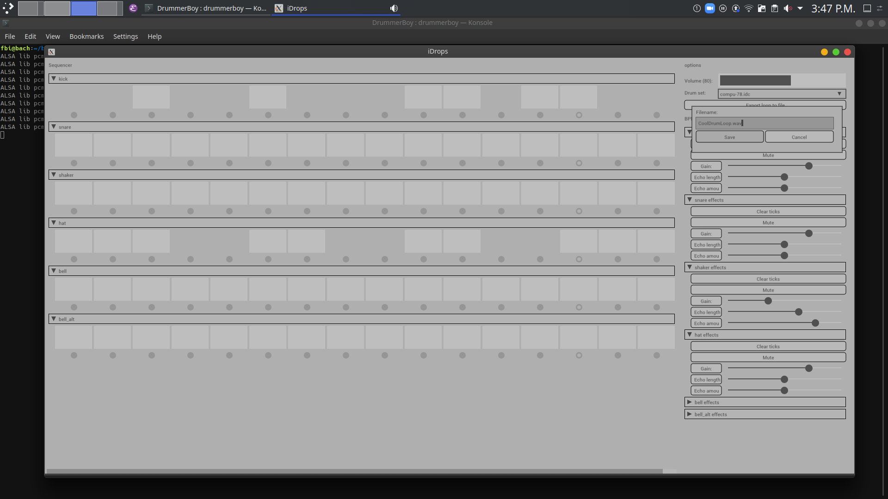
We can also save and export our beat pattern creation as a .wav file

Slide 22
For more information about the iDrop
Please feel free to visit our website.

Slide 23
Thank you for your time.

